Slide 1

Lecture – 12/8/2016
CSCI 36300 – Software Design

Slide 2
Assignment #5 – Phase II
Due Date:
Friday (12/9) @ 11:59 PM
Checklist:
Address any comments from Phase I.
Also – address feedback from Assignment #1.
All necessary files included.
MPC/Source/Shared Object/Driver/README
Does your code compile/run on Tesla?
Is the code in your master branch of your repo the code you want me to grade?
Are you attempting the Extra Credit (Frameworks)?
If so you need to create the corresponding repository.

Slide 3
Final Exam
Date:
December 15th, 2016
Time:
10:30 AM – 12:30 PM
Location:
LD 004
Format:
True/False (10) – 20 Points
Short Answer (8) – 80 Points

Slide 4
Final Exam Review

Slide 5
Object-Oriented Programming
Four Pillars of Object-Oriented Programming:
Encapsulation
Data Hiding
Inheritance
Polymorphism

Slide 6
Patterns
What does a pattern do?
Documents a recurring problem/solution paring within a given context.
Problem/Solution binding – how they are related.
Recurrence is the key!
Note the use of the word context.
Patterns vs. Experience
Documented & Shared

Slide 7
Types of Design Patterns
 | Creational | Structural | Behavioral
Description | Concerns the process of creating objects. | Concerns the composition of objects or classes. | Concerns the way in which objects or classes interact and the distribution of responsibility.
Examples | Factory, Builder | Controller, Façade | Visitor, Template

Slide 8
C++ Inline Files
Motivation:
Organizational tool for C++ development.
They provide a way to outline your code and separate the interface from the implementation.
Reduces code clutter.
Significant benefits when dealing with large projects and specifically when dealing with many different classes.

Slide 9
C++ Review: Pointers
Pointers can point to local variables or a memory location located on the stack.
This gives us complete control over the access of memory within our program.
Example:
char ch = ‘a’;
char * ch_ptr = &ch;
Here we define a char and assign it a value ’a’, then we assign the memory location value of this variable to a new pointer using the & (address of).

Slide 10
C++ Review: Pointers
& = Address of Operator
This returns the memory address where the pointer is pointing to in memory.
* = Dereference Operator
This returns the value pointed to by the pointer.
When initializing a pointer ALWAYS initialize the pointer to NULL (or a known location) – otherwise you can have negative side effects.
int * ch_ptr = 0;

Slide 11
C++ Review: Abstract Data Types
The ADT Lifecycle:
Construction: The ADT is created.
Locally on the stack.
Dynamically on the heap.
Initialization: The variables of the ADT are set to their initial value.
Set the ADT’s initial state.
Usage: The ADT is now ready for use in program.
Invokes its member functions.
Destruction: The ADT and it’s memory is no longer usable.
Removed from the local stack.
Memory released back to heap.

Slide 12
C++ Review: Scope & Lifetime
Scope
Textual or Spatial
Lifetime
Temporal concept
C++
Let us consider a variable that is declared in a function using the specifier static – it is statically bound to the scope of that function and is also statically bound to storage.
Scope is static and local to the function – Lifetime extends over the entire execution of the program.

Slide 13
System Composition
System Composition
This idea is centered around the use of objects (hence the OO overview), which are made up of ADT.
Through system composition we can create much more robust software systems and in the end make our lives easier as developers.

Slide 14
Aggregation
Aggregation is when you compose an entity such that it contains other objects.
“Has-A” Relationship
Example:
A car has many different components, for instance a car has a engine. An engine can exist without a car.

Slide 15
Inheritance
Inheritance is when an object is based upon, or derived, from another related object.
“Is-A” Relationship
Example:
A dog is a type of mammal. A dog may have unique traits but it may also inherit traits from the mammal classification.

Slide 16
System Composition - Patterns
Aggregation
Software Design Patterns:
Wrapper Façade
Composite
Inheritance
Software Design Patterns:
Builder
Abstract Factory
Factory

Slide 17
Inheritance Types
Three types of inheritance found:
Public
The methods found in the base class keep their same scope.
Private
Only the public methods of the base class are accessible from the derived class.
Protected
The public and protected parts in the base class are protected in the derived class.

Slide 18
Multiple Inheritance
C++ allows for multiple inheritance.
This achieved by specifying additional base classes separated by commas.
class Rectangle: public Polygon, public Output {
Can cause significant problems if not used carefully.
Code Smell
The Diamond of Dread

Slide 19
Polymorphism
Polymorphism
Definition:
“The condition of occurring in several different forms.”
Allows for the creation of a generic software interface such that concrete collections of different objects may be manipulated uniformly.
Mammal Example

Slide 20
C++ Review: Abstract Classes
A Pure Abstract Class is a class that contains all pure virtual methods.
This is what we would typically refer to as an interface.
What would happen if we do not implement a pure virtual function from a base class in a derived class?

Slide 21
Exception Handling
An exception is any unusual event, erroneous or not, detectable by either hardware or software, that may require special processing.
The special processing that may be required after detection of an exception is called exception handling.

Slide 22
Exception Safety
Levels of Exception Safety
Strongest to Weakest
Failure Transparency
Strong Exception Safety
Basic Exception Safety
Minimum Exception Safety
No Exception Safety

Slide 23
Generic Programming
We, as computer scientist and software engineers, like to make things as abstract or generic as possible.
Why?
If we make components generic we can provide much greater reuse than if they are concrete.
Generic Programming:
The process of defining and implementing functions/classes in terms of generic types.

Slide 24
Template Programming
Let’s look at the general definition of a template.
Nothing more than a blueprint that is not specific to a particular situation.
Write once and apply over and over (with slight modification for use).
In software terms:
A template is nothing more than a “blueprint” for creating a generic function or class.

Slide 25
C++ Review: Type Inference
How do we allow for type inference in C++ templates?
C++11 Standard
Auto Keyword
If the compiler can infer the type of a variable at the point of declaration you can use auto instead of the type name.
int x = 4; VS. auto x = 4;
Benefit:
Cleaner, more readable, code.
Consequence:
More readable?

Slide 26
Namespaces
Namespaces allow you define the context in which names are defined.
Essentially we are defining the scope in our program.
So why is “using namespace std;” a bad practice?
We have suddenly made this namespace the global namespace – what happens if we call a function that is included in std?

Slide 27
Assertions
A function/macro that allows you to test your code based upon a given condition.
If that condition is satisfied the assertion passes.
If the condition is not satisfied the assertion fails.
Potential Dangers?
If the assertion fails it terminates the program – sometimes hard to decipher error.
What if we leave the assertions in and go to release our code?

Slide 28
Function Pointers
Pointer
A variable that holds the address of another variable.
Function Pointer
A variable that holds the address of a function.
In C++ this is one method for achieving dynamic dispatching.
Dynamic dispatching is the process of selecting which implementation of a polymorphic operation to call at run-time.

Slide 29
Functors
Functors are an object of a class type that implements the function-call operator, allowing the object to be used within expressions using the same syntax as a function call.
Functors are stateful objects, being able to contain their own data values and allowing the programmer to emulate closures.

Slide 30
Functors
How do we use functors in C++?
We must overload the () operator – aka the function call operator.
This is one of the most flexible operator overloads possible.
Wait…but what is a closure?
Let’s consult our good friend Theory of Programming Languages…
Similar to Lambda Functions
C++11

Slide 31
Principles of Rotten Design
Four Symptoms of Rotten Design:
Rigidity
Fragility
Immobility
Viscosity
Each of these symptoms is related to one another – but it may not always be clear.
It is our job, as software engineers, to be able to identify these and handle them accordingly.

Slide 32
Rotten Design – Two Phases
Active Rot
Continuous changes in the code.
Lose integrity over time.
New Requirements = New Bugs
Dormant Rot
Unused software the primary cause.
Possibly from a failed implementation.
Customer changed their mind.
Found a better way but did not clean up after ourselves.
Etc.

Slide 33
The Open Closed Principle (OCP)
“A module should be open for extension but closed for modification.”
-Bertrand Meyer
What does this mean?
We should design and write our code such that our various components can be reused without the need for modification.
Change the behavior and not the source code.

Slide 34
Liskov Substitution Principle
“Subclasses should be substitutable for their base classes.”
-Barbara Liskov
Derived classes (child) should be substitutable for their base classes (parent).
Something that uses a base class should continue to function properly if a derivative of that base class is passed to it.

Slide 35
Dependency Inversion Principle
Depend upon Abstractions.
Do not depend upon concretions.
A principle of depending upon interfaces or abstractions, rather than upon concrete implementations.
Core principles of OO Design
Never target a concrete class – always use an abstraction.
Why?

Slide 36
Interface Segregation Principle
This principle states:
Many client specific interfaces are better than one general purpose interface.
What does this mean?
If you have a class that has several clients, rather than loading the class with all the methods that the clients need, create specific interfaces for each client and multiply inherit them into the class.

Slide 37
Principles of Package Architecture
Three Key Principles:
Release Reuse Equivalency Principle
Common Closure Principle
Common Reuse Principle
What do these three principles provide us when constructing software systems?
What are the benefits of using each principle – and can they be used together?

Slide 38
Package Coupling Principles
Three Principles:
Acyclic Dependencies Principle
Stable Dependencies Principle
Stable Abstractions Principle
The key is to focus on the communication between the various components.
Don’t force something if it isn’t there.

Slide 39
What is Coupling?
Coupling between classes is nothing but dependency of one class on another class.
Coupling is one of the factors to consider in improving a design.
Measures the strength of all relationships between functional units.
Tied closely with cohesion (Low → High).

Slide 40
Command Pattern
Role:
Command Objects = Black Box
Execute method is known to be available but no information regarding the specific logic is known.
Commonly Found:
GUI’s
Menu Bars
Progress Bars
Parallel Processing
Event-based actions

Slide 41
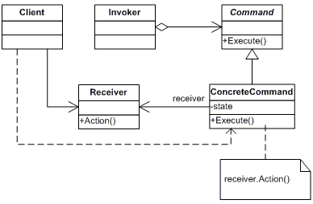
Command Pattern

Slide 42

Abstract Factory Pattern
Classification:
Creational Design Pattern
Problem:
Hide the implementation details from the client.
Solution:
Provide an interface for creating families of related or dependent objects without specifying their concrete classes.

Slide 43
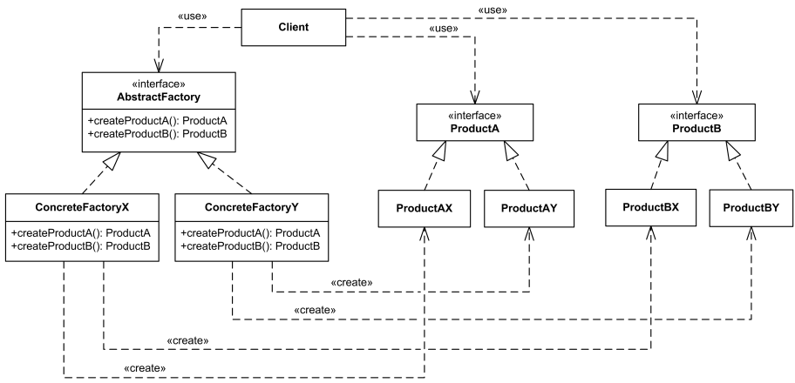
Abstract Factory Pattern

Slide 44
Abstract Factory vs. Factory
The Factory Method pattern creates objects from a particular base.
This approach makes use of inheritance.
The Abstract Factory pattern creates a factory that creates other factories.
This approach makes use of composition.
Assignment 4 we are going to be using a Tree rather than a Stack.
Instead of having to do a complete re-write we can simply reuse our existing Factory that can create a Stack Factory…and a Tree Factory.

Slide 45

Composite Pattern
Pattern Classification:
Structural Pattern
Problem:
We need a way to treat “things” differently even if they appear to be used in the same way.
Solution:
Compose objects into tree structures to represent the part-whole hierarchies

Slide 46
Composite Pattern
Compose objects into tree structures to represent part-whole hierarchies.
Composite lets clients treat individual objects and composition of objects uniformly.

Slide 47
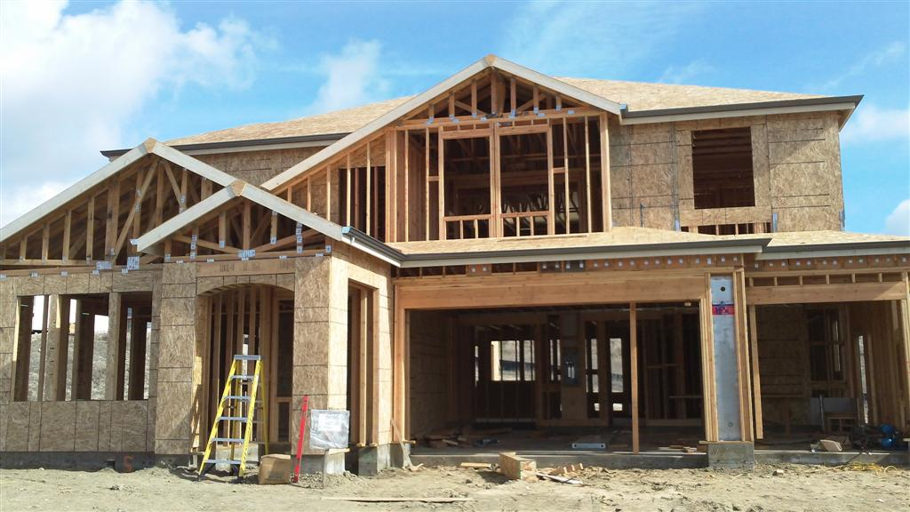
Builder Pattern
Pattern Classification:
Creational
Problem:
Building a complex object but want to shield the client from the complexity.
Solution:
Separate how we construct a complex object from its representation. This shields the client.

Slide 48
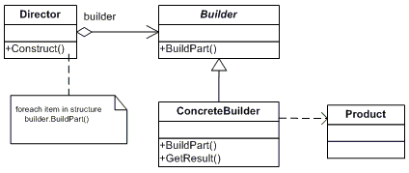
Builder Pattern

Slide 49

Visitor Pattern
Pattern Classification:
Behavioral Pattern
Problem:
You want to perform operations on a class without having to modify the source.
Solution:
Lets you define a new operation without changing the classes of the elements on which it operates.

Slide 50
Visitor Pattern

Slide 51
Visitor Pattern
Double Dispatch
The operation that gets executed depends on the kind of request and the types of the two receives.
Accept is an example as shown on the previous slide of a double dispatch operation.
It depends on two types: the Visitor’s and the Element’s.
Lets visitors request different operations on each class of element.
Key aspect of the Visitor pattern!

Slide 52
Iterator Pattern
Pattern Classification
Behavioral Pattern
Problem:
Need to "abstract" the traversal of different data structures so that algorithms can be defined that are capable of interfacing with each transparently.
Solution:
Take the responsibility for access and traversal out of the aggregate object and put it into an Iterator object that defines a standard traversal protocol.
Generic Programming

Slide 53
Iterator Pattern
Pattern Intent:
Provide a way to access the elements of an aggregate object sequentially without exposing the underlying representation.
Common Theme:
Shield the complexity from the client.

Slide 54

Adapter Pattern
Pattern Classification:
Structural Pattern
Problem:
Allow existing classes work with other components without modifying their source code.
Solution:
Allow the interface of an existing class to be used as another interface.

Slide 55
Adapter Pattern

Slide 56
Proxy Pattern
Pattern Classification:
Structural Pattern
GOF: pp. 207
Problem:
You do not want to instantiate a complex object unless they are actually requested by the client.
Solution:
Provide a surrogate, as a go-between, in order to provide access to the object as needed.

Slide 57
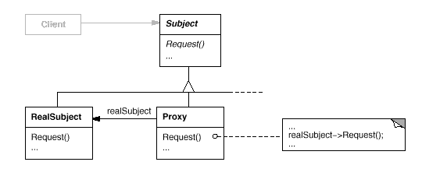
Proxy Pattern

Slide 58
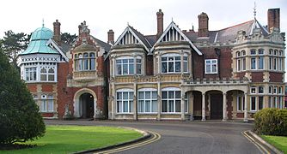
Façade Pattern
A façade is an object that provides a simplified interface to a larger body of code.
Architectural Façade
“Front Facing”
Pattern Classification:
Structural Pattern
GOF: pp. 185
Defines a higher-level interface that makes the subsystem easier to use.

Slide 59
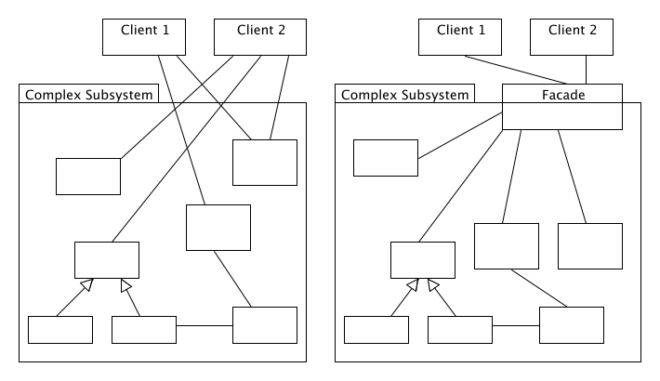
Façade Pattern
http://best-practice-software-engineering.ifs.tuwien.ac.at/patterns/facade.html

Slide 60
Shared Libraries
Shared libraries allows you to create programs that can break down functions, classes, and components into several different binary files.
Just imagine if we had to pull in code every time we wanted to handle standard input and output and compile and run that code alongside our own files.
Tedious, error prone, code bloat, etc.

Slide 61
Shared Libraries
Compile Time
If everything was in one single binary file the compile time of even the smallest of programs would be massive.
Libraries allow for reuse of existing binaries so we don’t have to constantly recompile the entire C++ language.
Compile Once → Use Many

Slide 62
Frameworks
What is a (software) framework?
“An abstraction in which software providing generic functionality can be selectively changed by additional user-written code, thus providing application-specific software.” –Wikipedia
What is the difference between a software framework and a library?
How do our design patterns/principles fit into this?

Slide 63
Frameworks
Shared Libraries
A packaged collection of object files that program can link against.
The linker just stores a reference to the library and the library itself is not packaged in the main executable.
Frameworks
A bundle, most often a directory structure, that contains shared libraries as well as sub directories of headers and other resources necessary for use together.

Slide 64
Frameworks vs. Libraries
Inversion of Control
When we call a method from a library we are in control, but with the framework the control is inverted, the framework calls our code.
GUI code in Java is a framework that calls our code through event handlers.
A library is essentially a set of functions (well defined operations) that we can call (organized into classes). Each does some work and then returns the control to the client.

Slide 65
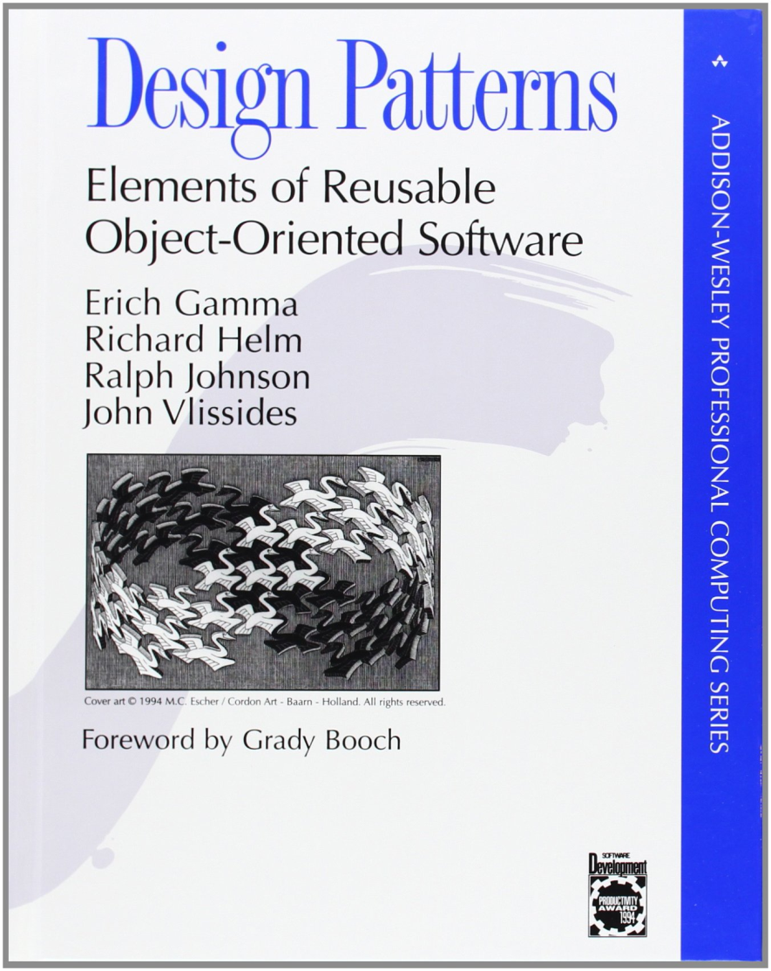
Software Anti-Patterns
What is a software anti-pattern?
“A common response to a recurring problem that is usually ineffective and risks being highly counterproductive.” – Wikipedia
Andrew Koenig
1995

Slide 66
Software Anti-Patterns
How do we formally define what an anti-pattern is in software?
How do we distinguish it from just simply a bad habit or bad programming style?
Two Elements:
A commonly used process, structure or pattern of action that despite initially appearing to be an appropriate and effective response to a problem, typically has more bad consequences than good ones.
Another solution exists that is documented, repeatable and proven to be effective.

Slide 67
Software Anti-Patterns
Continuous Obsolescence
Ambiguous Viewpoint
Functional Decomposition
Boat Anchor
Spaghetti Code
Walking through a Minefield
Cut-and-Paste Programming
Mushroom Management

Slide 68
Code Smells
Types of code smell:
Bloaters
Object-Orientation Abusers
Change Preventers
Dispensables
Couplers
Is this a complete list?
No, there are many different “smells” that exist in code.

Slide 69
Refactoring
Refactoring Techniques:
Composing Methods
Moving Features between Objects
Organizing Data
Simplifying Conditional Expressions
Simplifying Method Calls
Dealing with Generalization

Slide 70
Thank You!

